Slide 1
Anomaly Propagation on Graphs lecture-8 Course on Graph Neural Networks for Knowledge-Graph Systems (Winter Term 22/23)
Prof. Dr. Holger Giese (holger.giese@hpi.uni-potsdam.de)
Christian Medeiros Adriano (christian.adriano@hpi.de) - “Chris”
Matthias Barkowsky (matthias.barkowsky@hpi.de)
Iqra Zafar (iqra.zafar@hpi.de)

Slide 2
Lecture topics
Overview of Spatio-Temporal Project Seminar
Problem Definition
Motivation
Contribution
Anomaly Propagation Graph (Source Graph)
Synthetic sub-Graphs (Target Graph)
Graph Matching
Evaluation

Slide 3
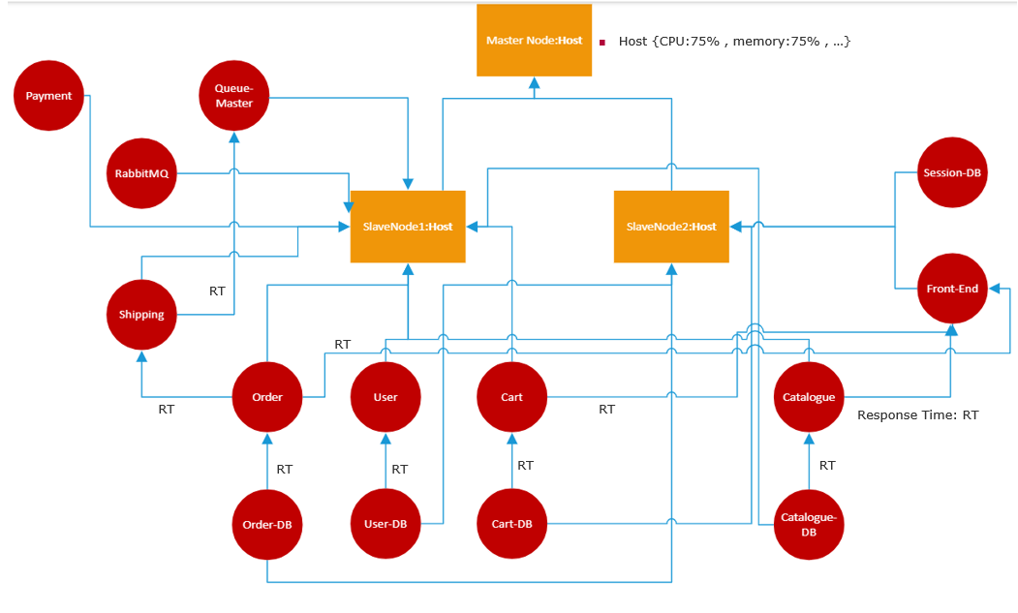
Problem Definition
Anomaly Propagation in microservices cloud application
Notes:
We begin with a scenario of an example of failure propagation—when multiple services stop working for some reason, we want to know why and how it happened so that we can prevent similar failures from happening in the future. It helps us to choose more appropriate actions to take, based on knowledge of which microservices are most likely at fault and/or whether there are other resources that could be affected by similar failures

Slide 4
Motivation
Exploring Spatio-Temporal Graphs as Means to Identify Failure Propagation
Spatio-Temporal representation allows a more realistic depiction of dynamic networks
Graph matching task for querying Spatio-Temporal graphs

Slide 5
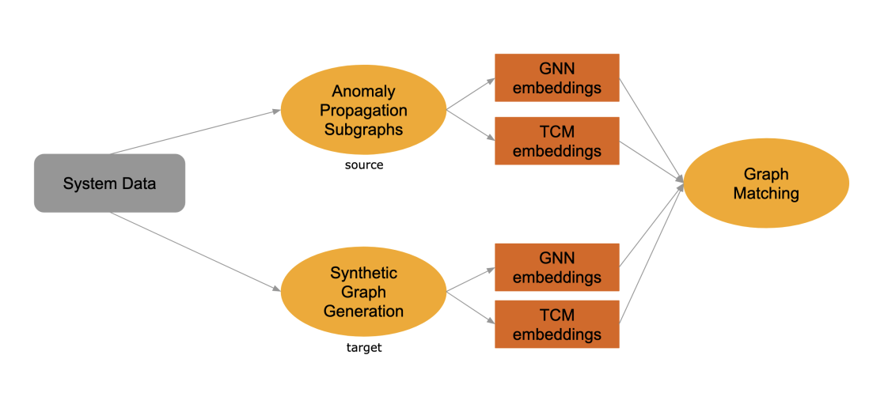
Project Contribution
(1) generation methods for failure propagation subgraphs from the data as well as
synthetically with Generative Adversarial Networks
(2) Graph matching for failure propagation subgraphs with a GNN compared
to matching via temporal centrality metrics (TCMs)

Slide 6
Anomaly propagation subgraphs (APG) –Source Graph
Anomaly detection(SPOT Algo)
Propagation causalities (Granger Causality Test)
Static subgraph sampling (node2vec)
Timestep sampling ->Spatio-temporal graphs

Slide 7
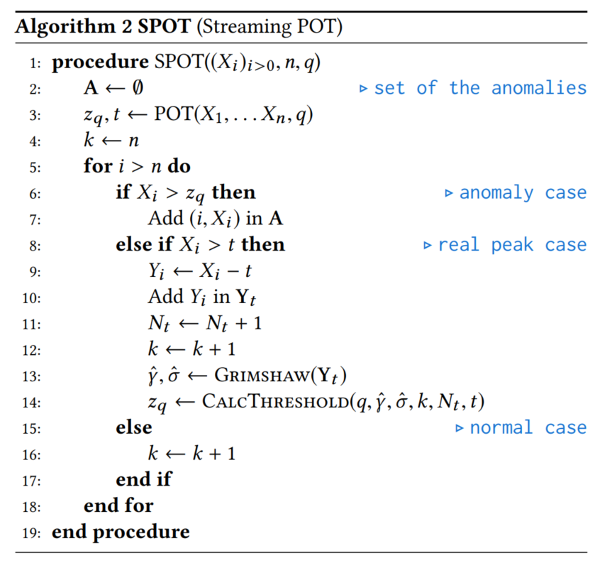
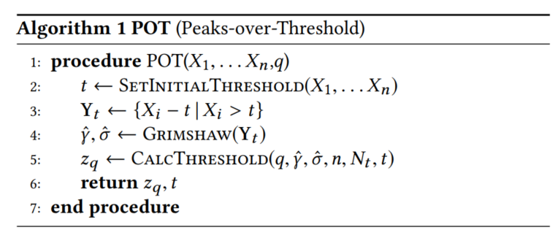
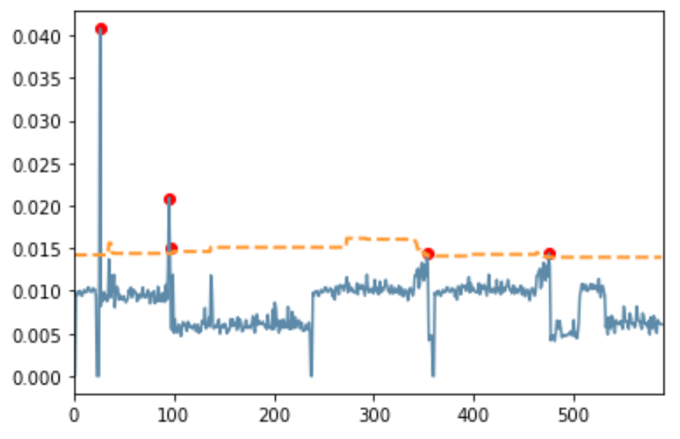
1. Anomaly detection(SPOT Algo)
Initialization step:
n observations X1, . . . Xn, q = desired probability
Compute a first threshold zq
The idea is to:
set a initial threshold t
retrieve the peaks (the excesses over t)
infer the distribution of the extreme values and
compute the threshold zq
Initialization step using POT Algo
Siffer, Pierre-Alain Fouque, Alexandre Termier, and Christine Largouet. Anomaly Detection in Streams with Extreme Value Theory 2017.

Slide 8
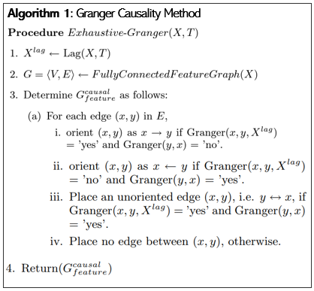
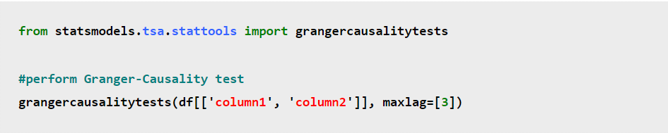
2. Propagation causalities (Granger Causality)
Idea:
Find real propagation in our sample data
Anomaly injected on front-end node
Granger Causality matrix
Capture correlation among time series data
Nodes correspond to service’s metric and edges represent causal relations among service’s metric
Cause
Effect
This test uses the following null and alternative hypotheses:
Null Hypothesis (H₀): Time series x does not Granger-cause time series y
Alternative Hypothesis (H_{A}): Time series x Granger-causes time series y

Slide 9
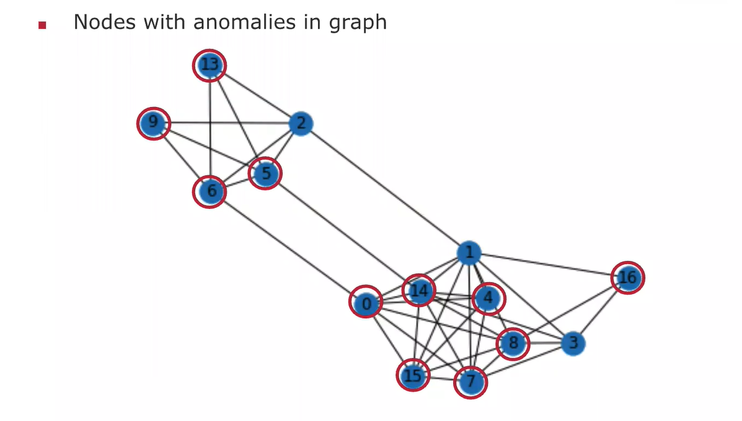
Anomaly propagation sub-graph

Slide 10
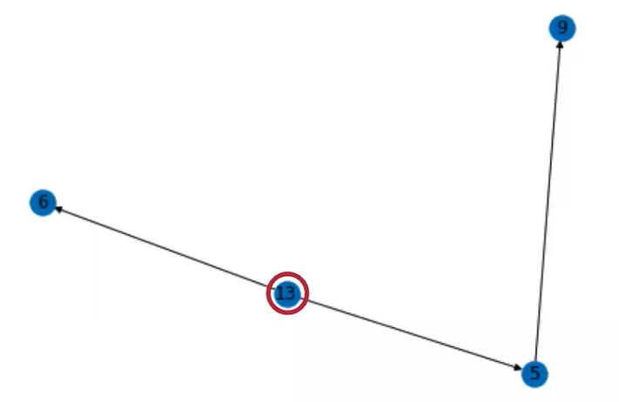
3. Anomaly Propagation Subgraphs
Problem:
Small result graph
Solution:
Loosen constraints and, sample graphs and timesteps

Slide 11
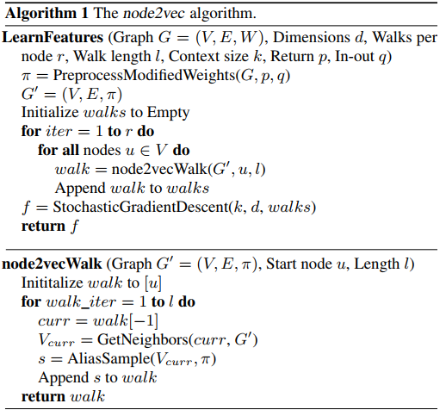
3. Static subgraph sampling (node2vec)
Based on the idea of the node2vec algorithm
Simplified random walk sampling based on a combination of breadth-first sampling (BFS) and depth-first sampling (DFS)
Traversing starts with fixed node(anomaly injected point) and cover only causal edges from our super-graph
Sample the subgraphs with directed edges
13
0
11
3
1
16
2
8

Slide 12
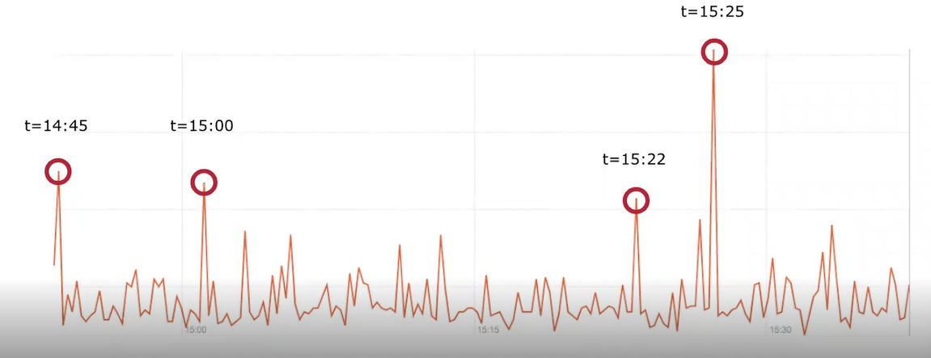
Definition of Time
Problem
Smallest time unit?
How to treat failures observed at the same time
Limited Sampled frequency (f= 1 sample/min)

Slide 13
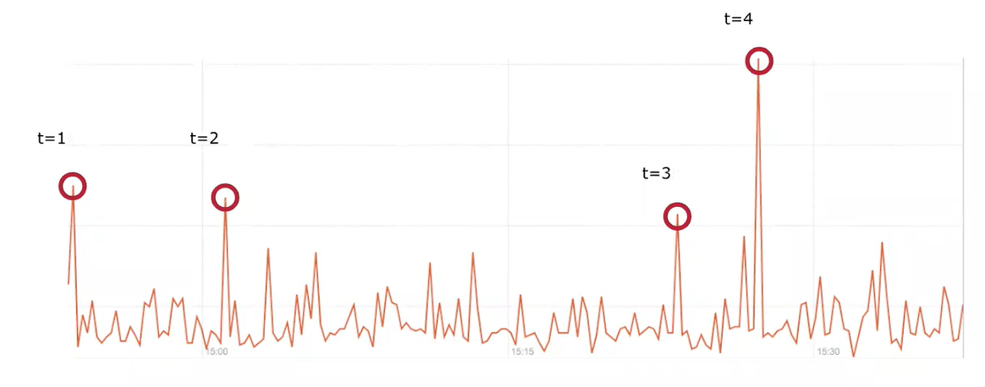
Definition of Time
Solution
Use relative time between anomalies
Choose order of anomaly propagation randomly if observed at the same time

Slide 14
4. Timestep sampling ->Spatio-temporal graphs
13
t1
0
(13,0)
1
11
3
1
16
2
(13,0)
8
Timestep sampling as anomaly propagation order steps

Slide 15
4. Timestep sampling ->Spatio-temporal graphs
13
t1
0
(16,3)
(16,1)
(16,8)
1
1
1
11
t2
3
t3
1
16
t4
2
(16,1)
8

Slide 16
4. Timestep sampling ->Spatio-temporal graphs
13
t1
0
(16,3)
(16,8)
(1,2)
2
2
1
11
t2
3
t3
1
16
t5
t4
2
(16,3)
8

Slide 17
4. Timestep sampling ->Spatio-temporal graphs
13
t1
0
(16,8)
(1,2)
3
2
11
t2
3
t3
1
16
t6
t5
t4
2
(1,2)
8

Slide 18
4. Timestep sampling ->Spatio-temporal graphs
13
t1
0
(16,8)
4
11
t2
3
t3
1
16
t6
t5
t4
2
t7
(16,8)
8
Timestep sampling as anomaly propagation order steps
Total: 18312 Spatio-Temporal subgraphs

Slide 19
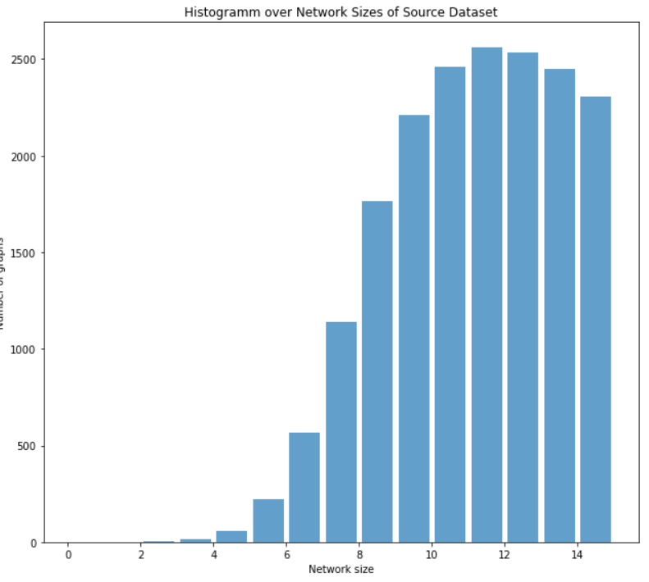
Source Graph Generation Result

Slide 20
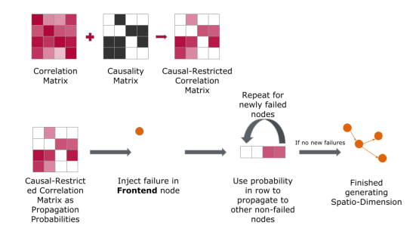
Synthetic sub-Graphs- Target Graph
Generating graphs using correlations and causality. The causal restricted correlation matrix is used to randomly sample anomaly propagations. Repeating

Slide 21
Deep Graph Generation
Approaches:
One Shot
GAN
MLP
Autoregressive
MLP
LSTM
Full-Sequence training (GAN)
Step-wise training

Slide 22
Graph Matching
The overall objective of project is to produce matches between different failure propagation graphs to learn from past behavior
graphs of different structures need to be compared to one another (Graph Matching Problem)
represents the problem of identifying correspondences across graphs, such that their respective structure is preserved
Implemented as graph similarity problem
Idea: Embed graphs, perform similarity computation in vector space
Goal: Embeddings of similar graphs should be close in vector space,
while embeddings of dissimilar graphs should be far apart
Producing GNN Embeddings
Producing TCM Embeddings
Li, Yujia, et al. "Graph matching networks for learning the similarity of graph structured objects." International conference on machine learning. PMLR, 2019.

Slide 23
Graph Matching - Algorithm
Produce source graph and target graph embeddings using GNN
Compute Euclidean distances between source and target graphs
For each source graph: Rank target graphs by distance
Measure ranking quality by comparing with TCM rankings
TCM Ranking : Ground truth
Closeness
Betweenness
Degree

Slide 24
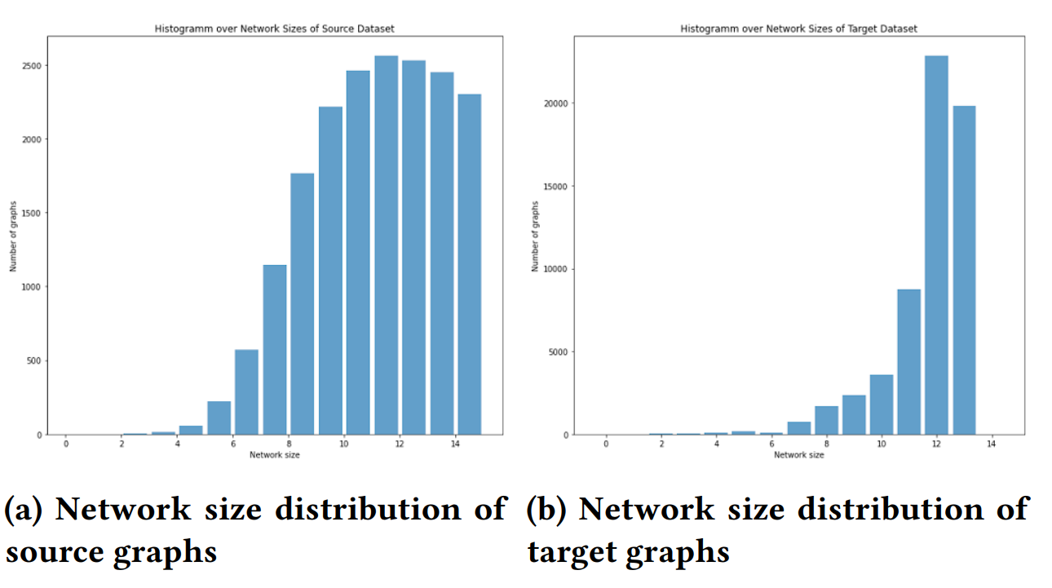
Graph Generation Results

Slide 25
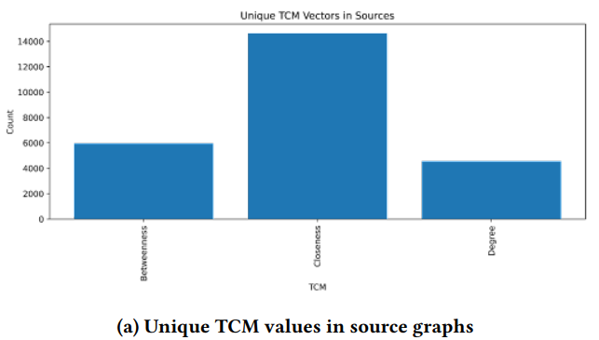
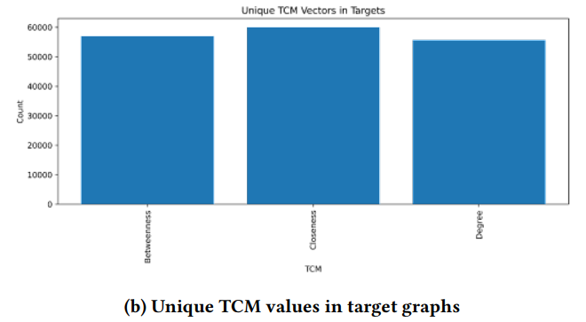
Graph Generation Results

Slide 26
END

